Slide 1

The PurplePages
Prepared by,
Gary Chiu - GUI designer/developer
Chengyuan Zhang - Backend Developer / Dataware Administrator
Matthew Dudycz - Backend Developer / Project Documenter
Wang Lyu - Backend Developer / Design and code inspector / Test Lead
Vatsal Shah - Developer / Technical Lead / Project manager
Western University
Final Demo

Slide 2
Agenda
Introduction
Service Offered
Architecture
Service Documentation
Service Registry
Deployment
Demo

Slide 3
Introduction: The PurplePages
Team - 01
Inspired by The Yellow Pages directory - a central business directory originally in book form, later updated to be online.
Our project provides directory information regarding Ski Resorts, Restaurants, Museums, and Fortune 500 Companies.
Integrated authentication service and only authenticated user can access all services.
Quality Attributes:
Security - Authentication
Usability - Accessibility, User interface aesthetic
Functional suitability - Functional completeness, Functional correctness
Portability - Installability
Maintainability - Modifiability, Testability
Performance efficiency

Slide 4
Services Offered
Team - 01
Service 1 - Ski Resort
Service 2 - Restaurants
Service 3 - Museums
Service 4 - Software companies
Service 5 - Frontend (GUI)
Service 6 - Registry and Discovery
Service 7 - Authentication service
Service 8 - Gateway
Matthew Dudycz

Slide 5
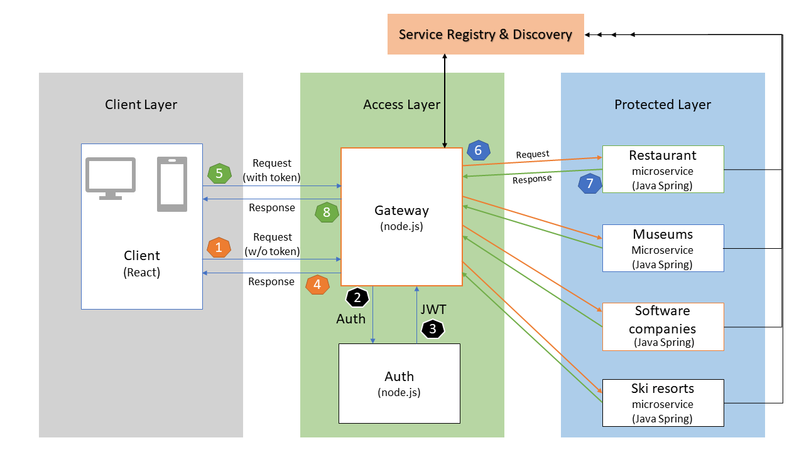
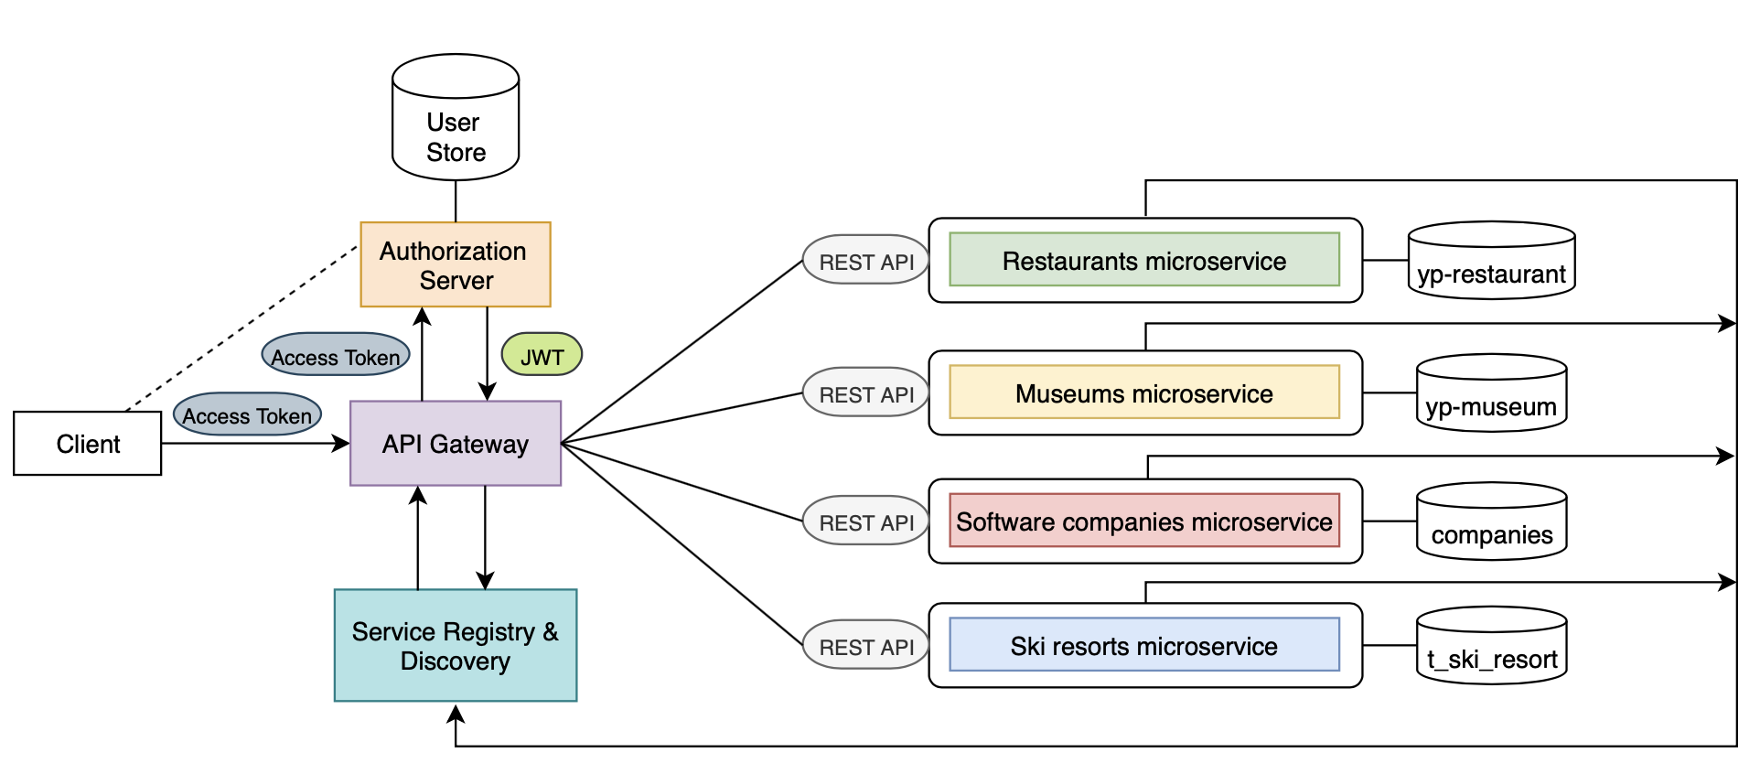
Architecture
Matthew Dudycz

Slide 6
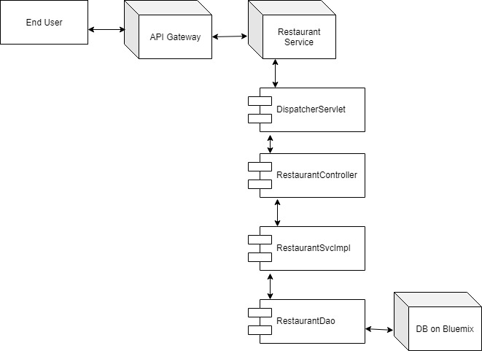
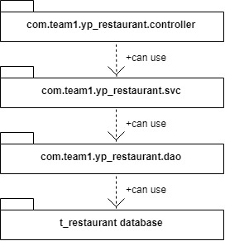
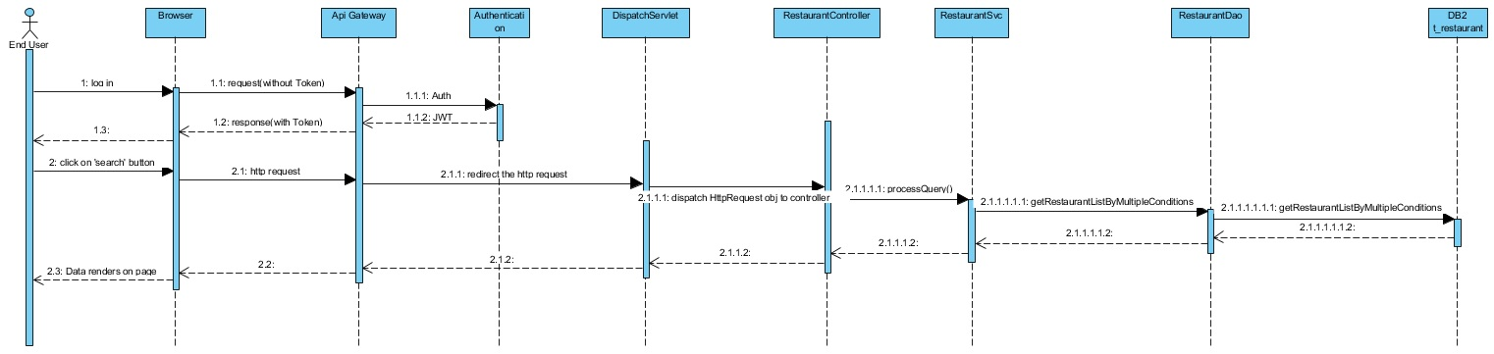
Service Documentation
Wang LYU

Slide 7
Service Registry
Team - 01
Framework : SpringCloud
Core Module:
Eureka Server - Service Registry
Eureka Client
Custom Client - Microservices
Gateway - Route
Service’s joining and Leaving Detection
Heart-beat from each end(registry and client)
Registry self-protection
Configure some parameters :P

Slide 8
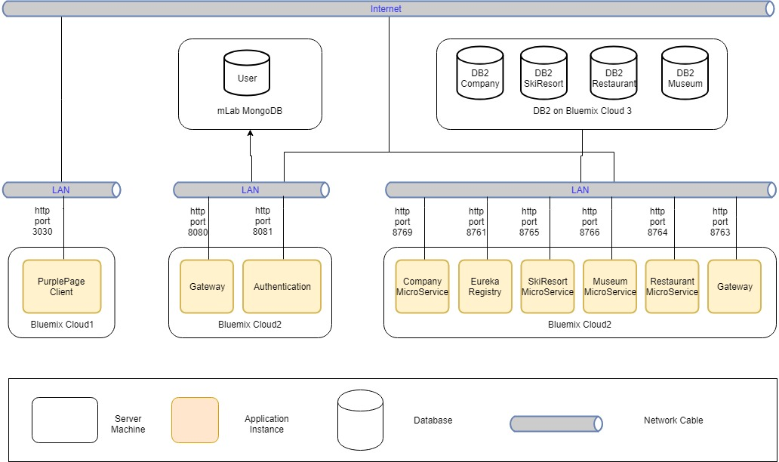
Deployment- Allocation View
Team - 01

Slide 9
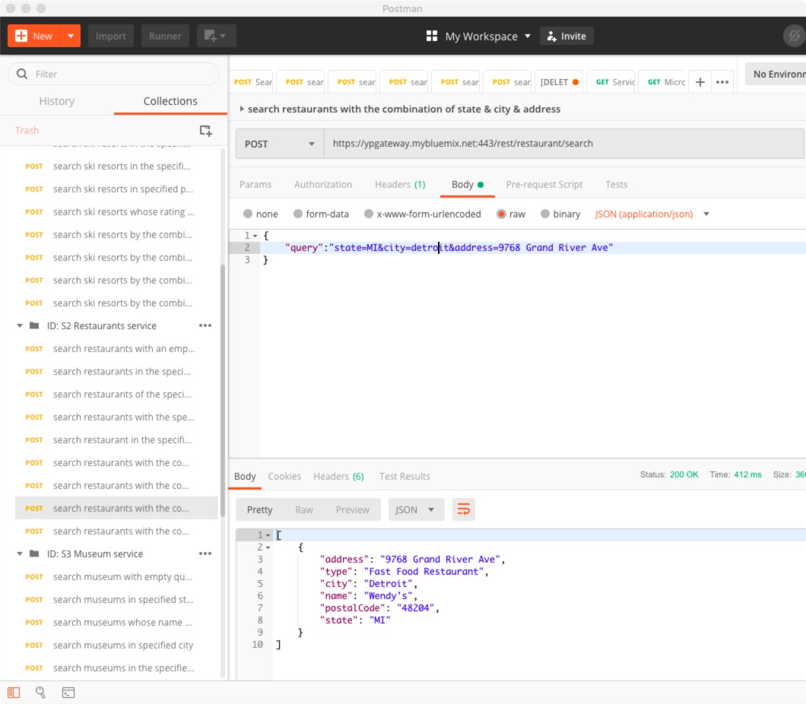
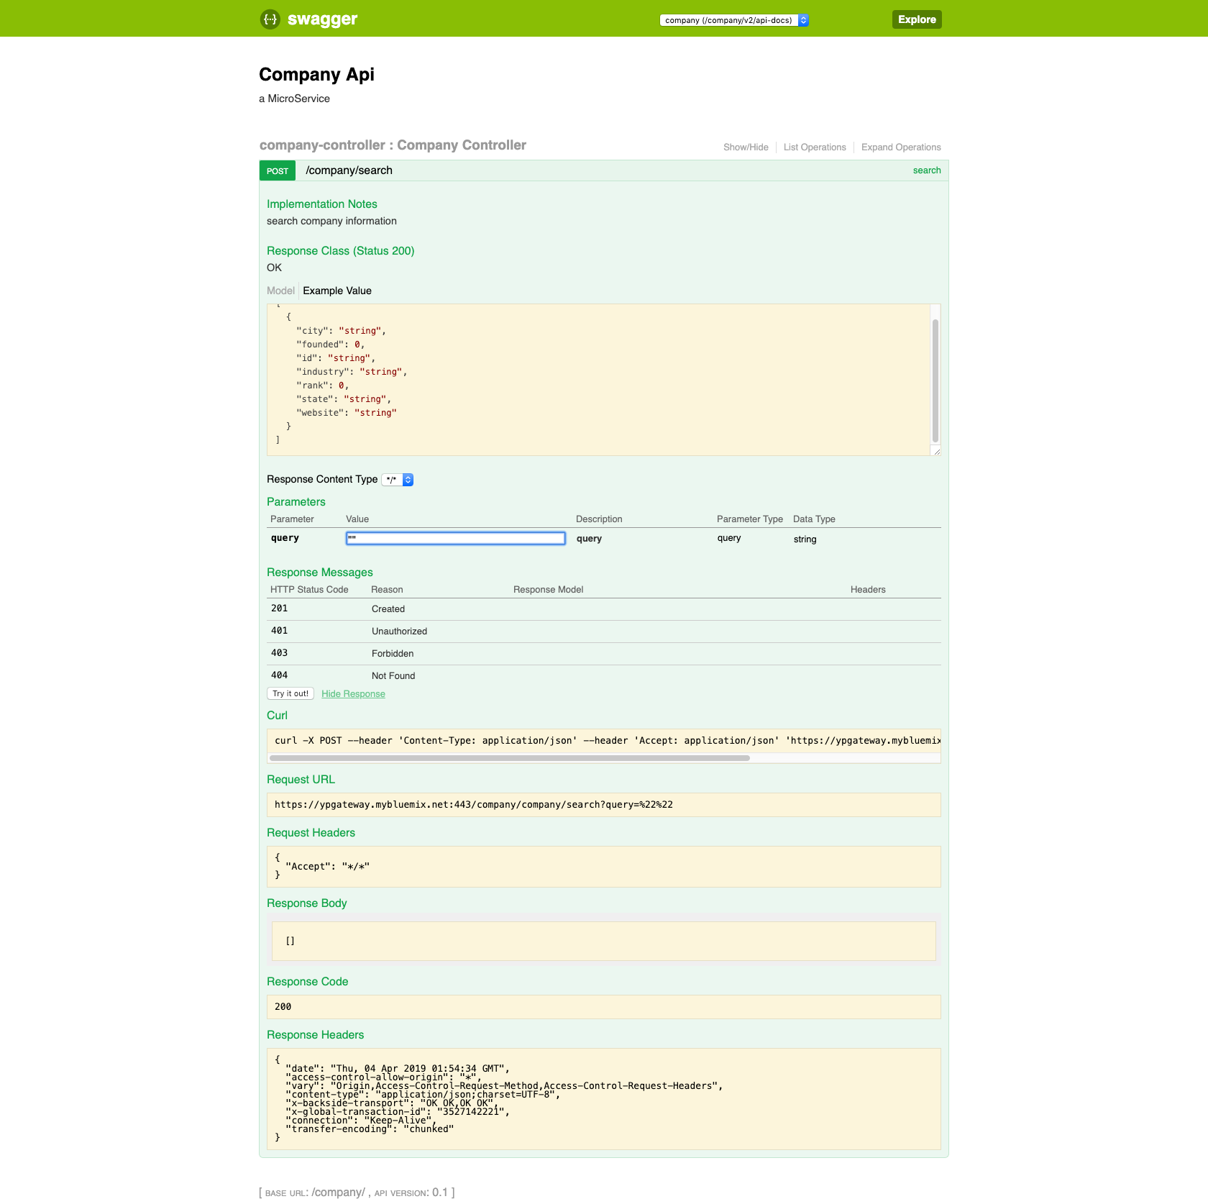
Team - 01
Test cases
https://ypgateway.mybluemix.net/swagger-ui.html

Slide 10
Project Demo
Team - 01
Let’s check it out
URL

